Slide 1
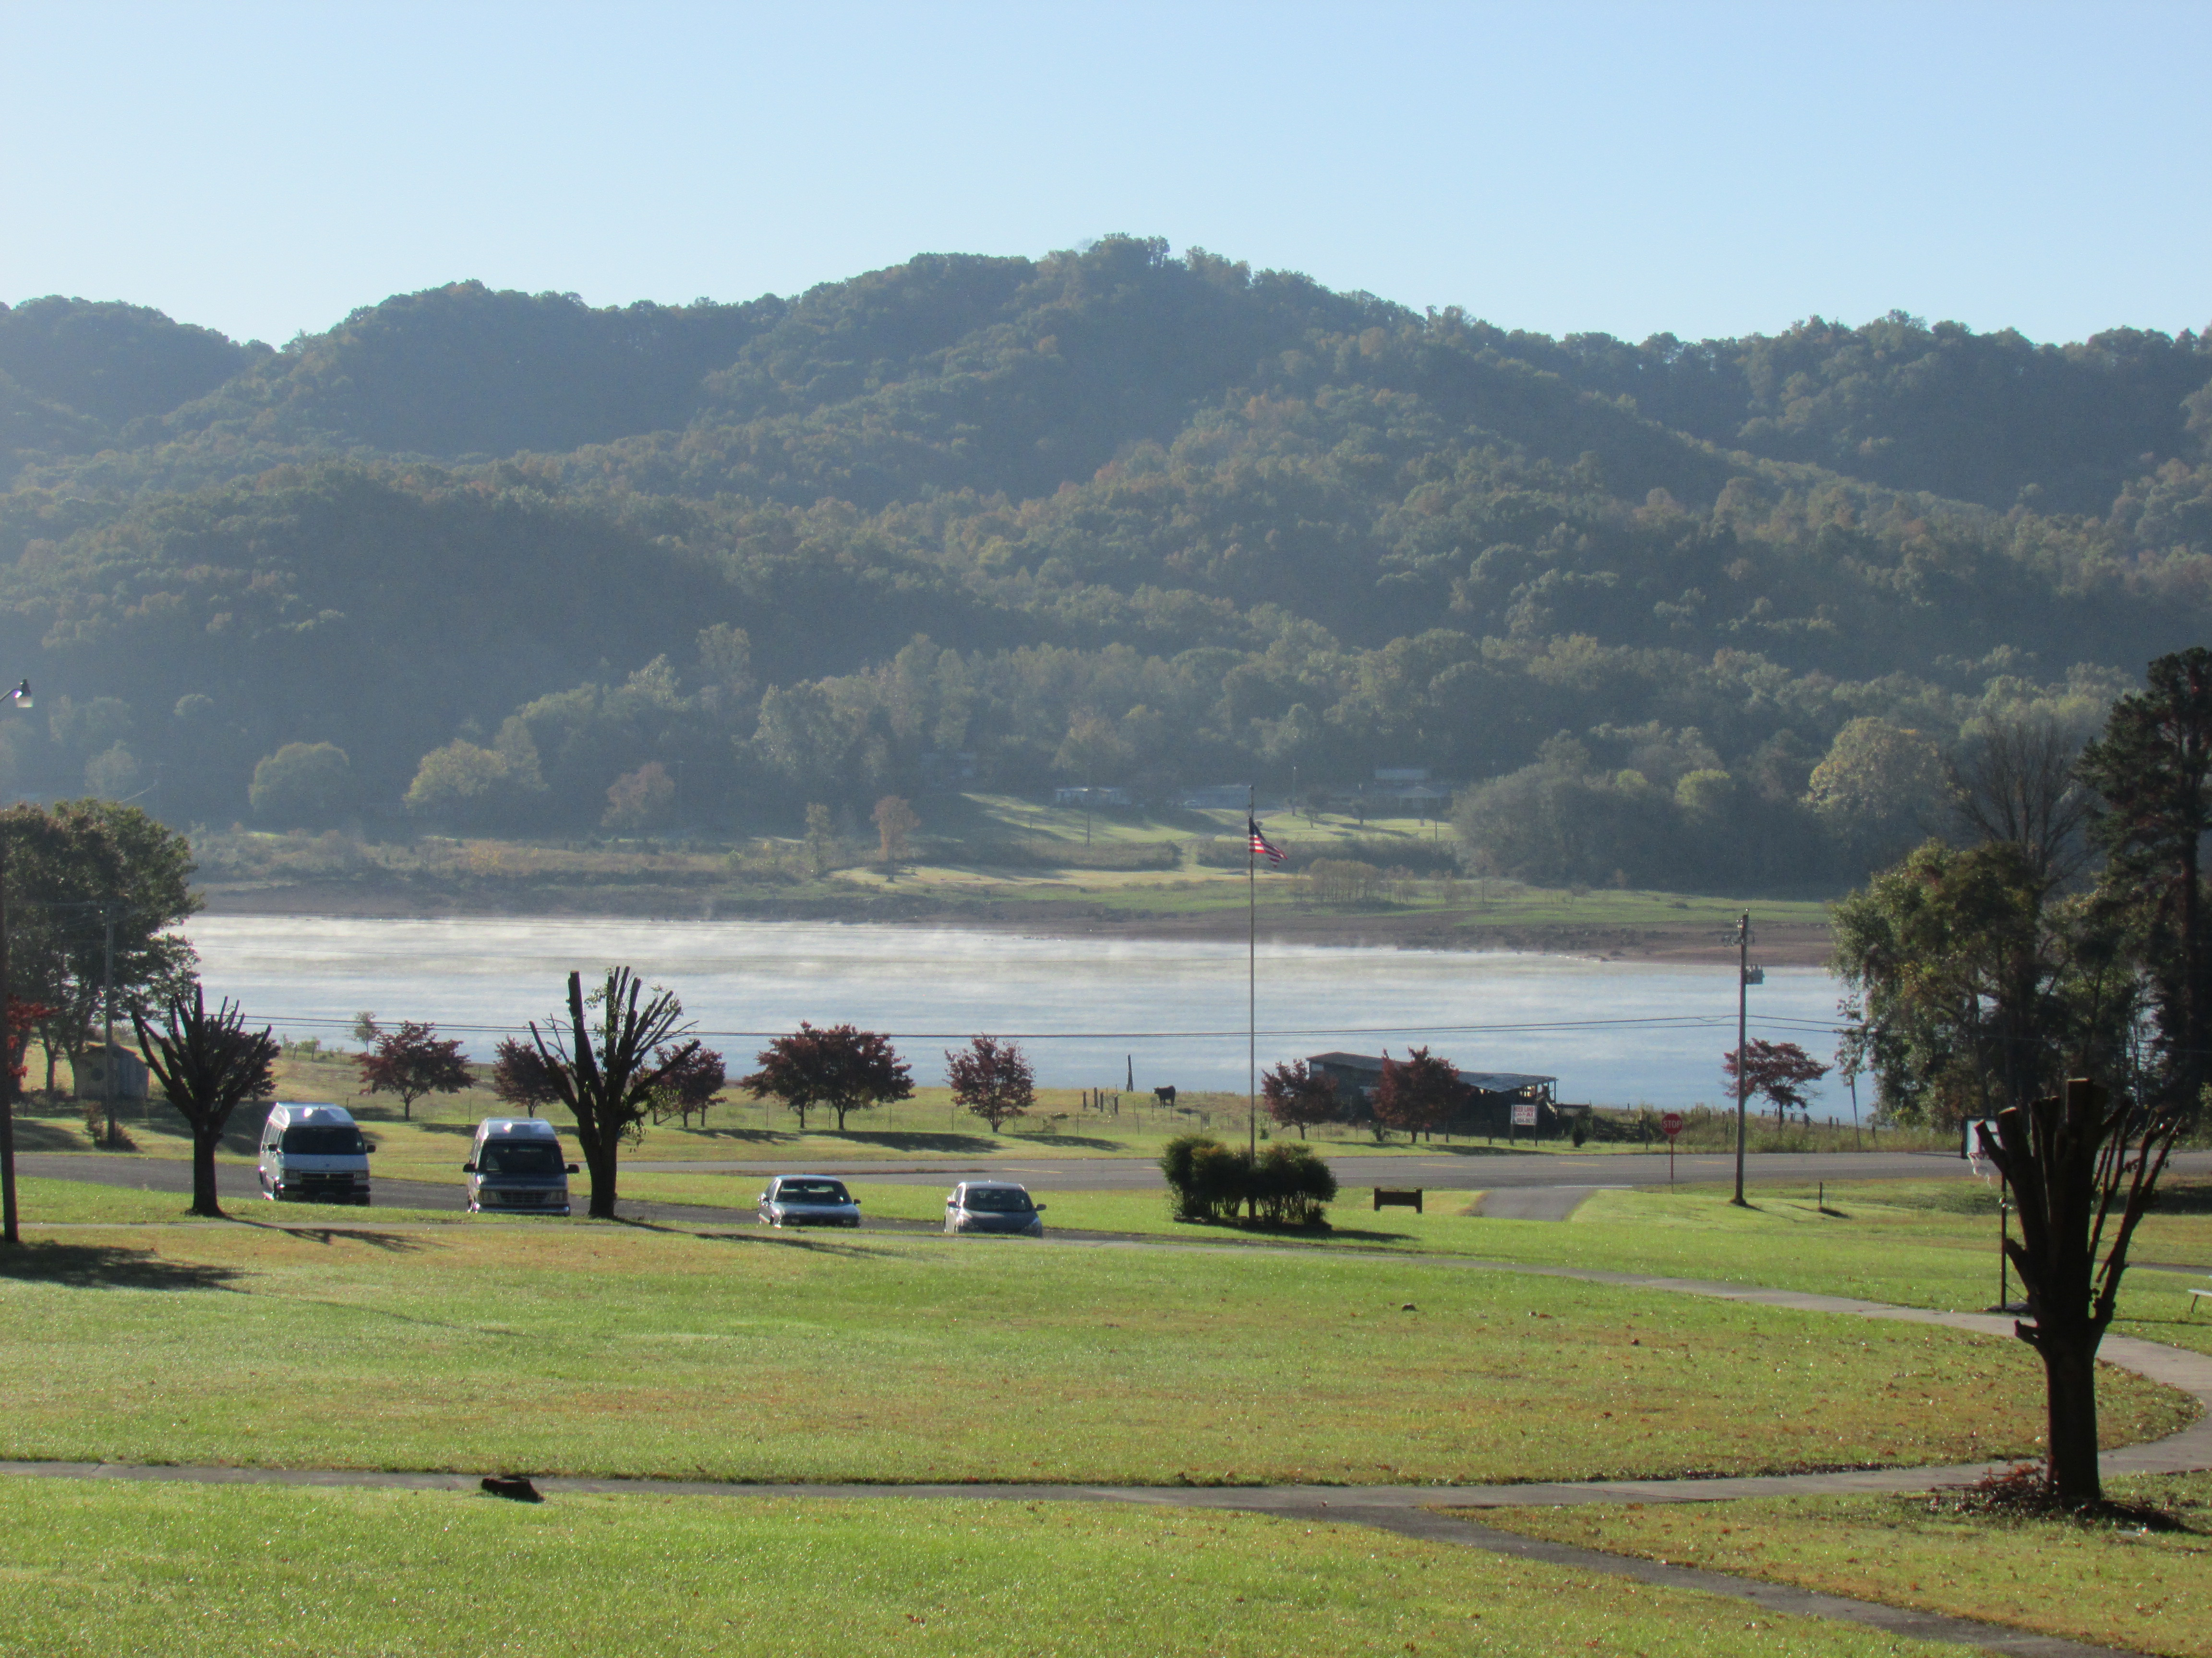

Appalachia Fall 2015
Glenmary Home Missioner’s Toppa Joppa Volunteer Program
Capstone Presenation

Slide 2
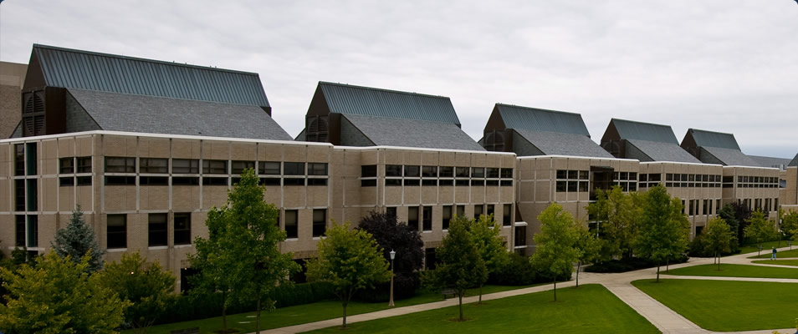
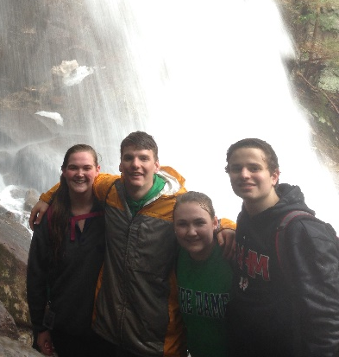
Pre-Immersion
Expectations ~ a second trip to Appalachia
Last spring at COAP was an amazing experience and a lot of fun.
How will this trip compare? Could it live up to my prior experience?
Completed an ePortfolio community profile on Grainger County, TN, and Glenmary’s program at Toppa Joppa
Talked in class about the Themes of Catholic Social Teaching – and expanded in an ePortfolio journal on two in particular:
Solidarity – we are all part of one family – keep our brothers and sisters across the world in mind in our day to day actions
Option for the Poor and Vulnerable – the poor and vulnerable must receive extra consideration and care because they have a difficult time defending themselves from disenfranchisement

Slide 3
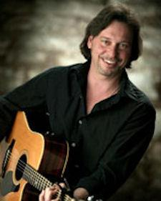
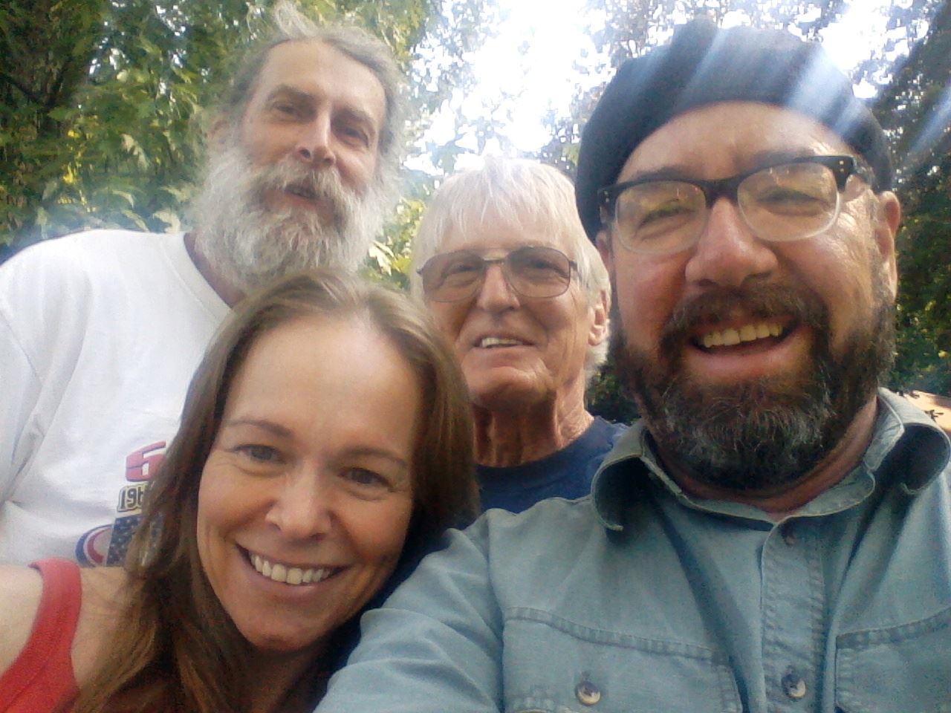

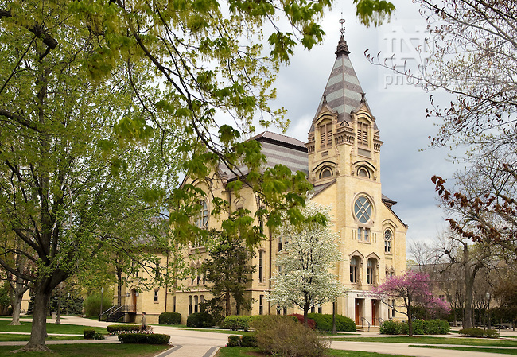
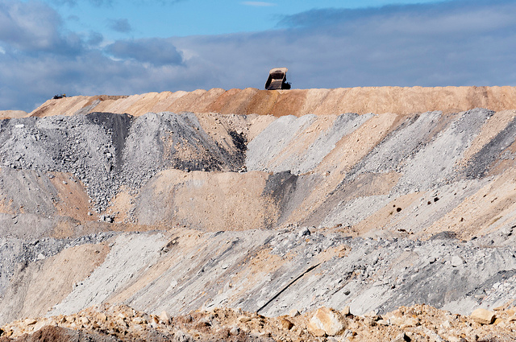
Appalachia Music Concert with The Emancipators and Tom Breiding
Overburden Documentary directed by Chad Stevens
Documentary revealing the struggles of Appalachian people in West Virginia with coal mining and a major coal company, Massey Energy
Sadly ends with Massey Energy’s victory to perform mountain-top removal on Coal River Mountain
Wrote an ePortfolio journal about the documentary and what it reveals about the Appalachian people
Two hours of Appalachia music, story telling and community
Pictures found online

Slide 4
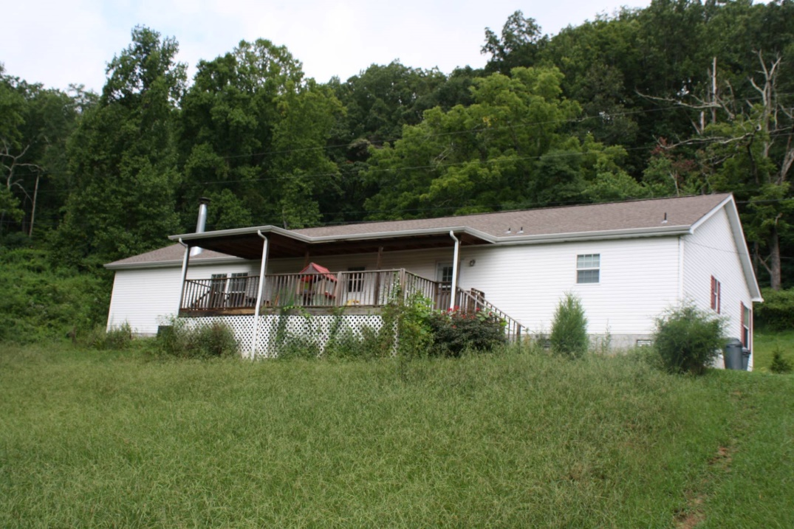
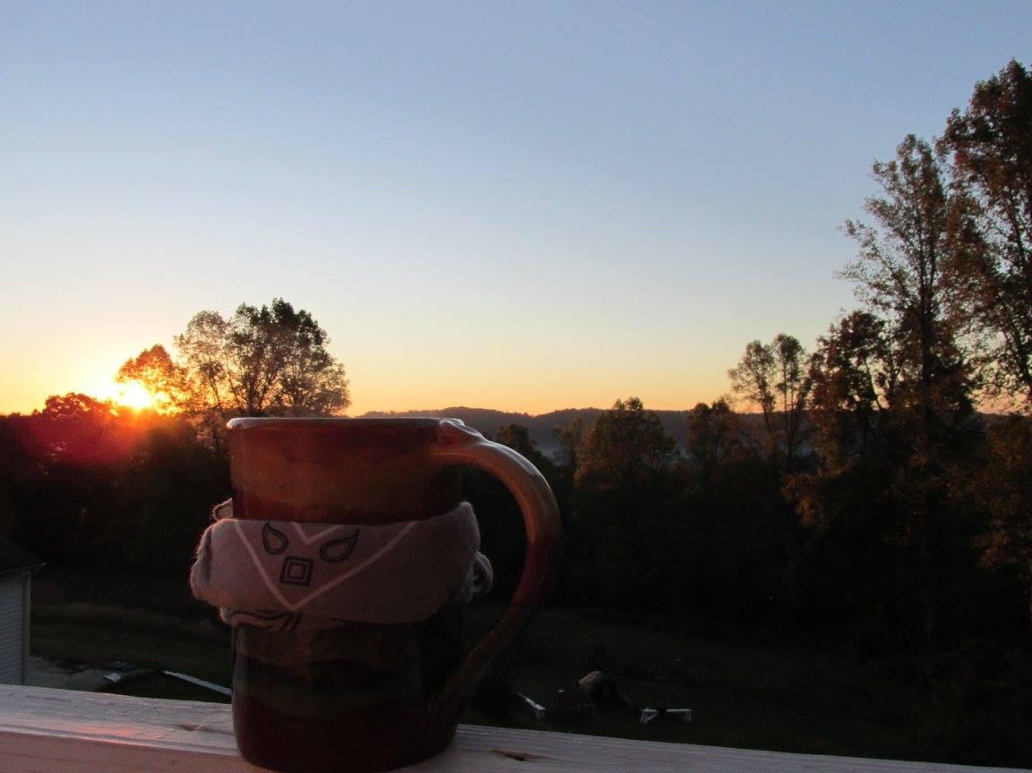
Glenmary Volunteer Program at Toppa Joppa
Beautiful home and piece of property on Joppa Mountain
But some surprises…
Would be living with Mark and Mia
Regimented schedule – that we were not even allowed to kn0w
We would be on “God’s Time”
Instead of minutes and hours, we lived on Clicks and Units – and Mark and Mia never told us what they had planned for us, until it was one Unit before we were ready for the activity
Absolutely NO cell phone usage permitted
This immersion would be VERY different from last Spring’s…

Slide 5
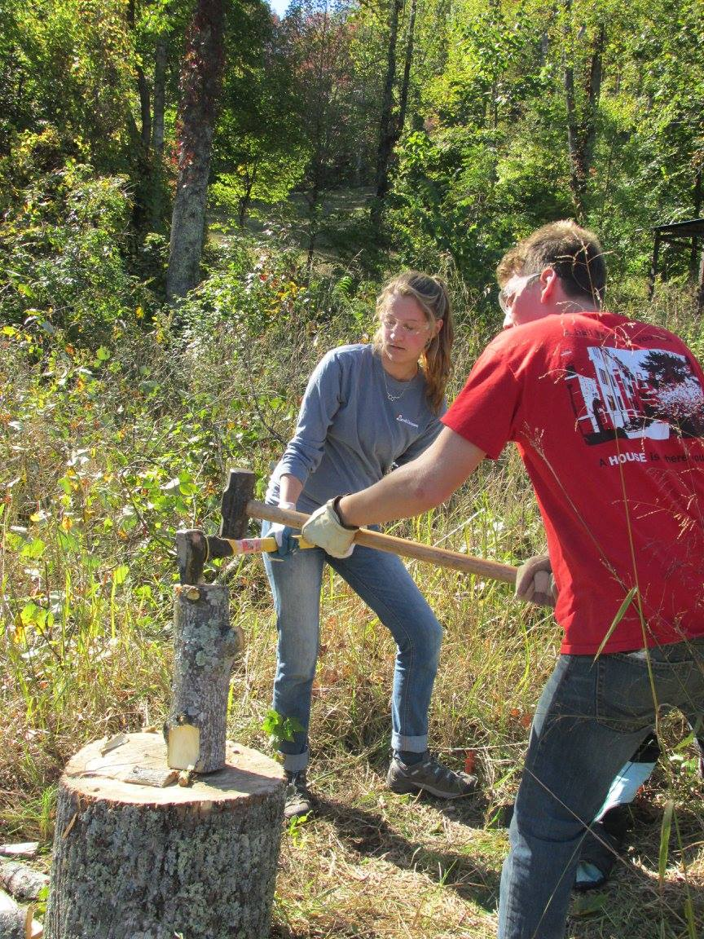
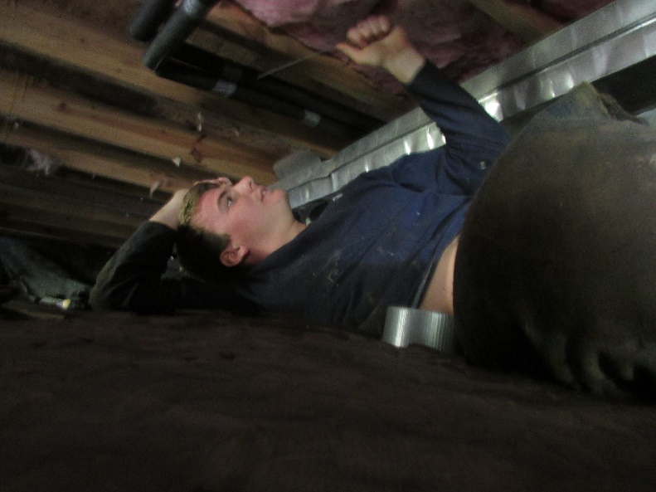
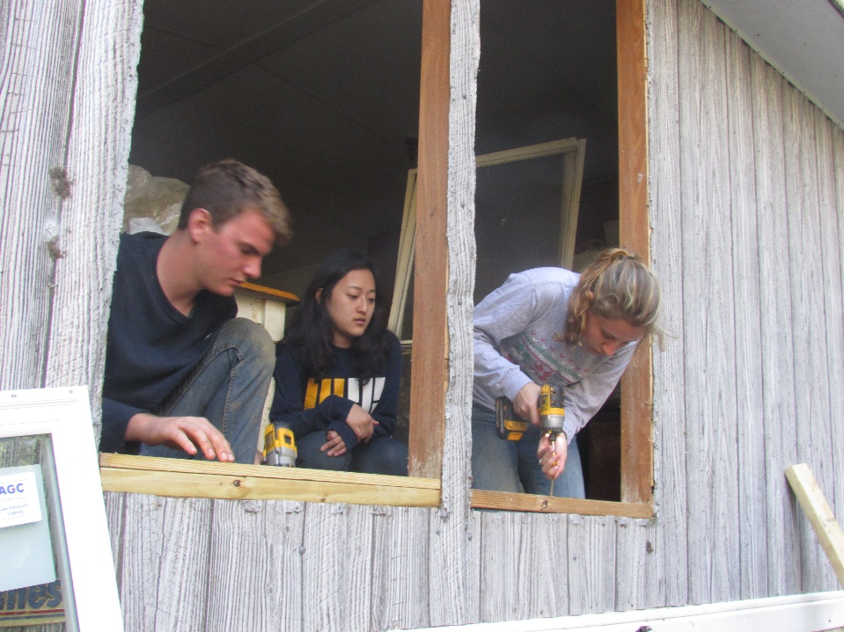
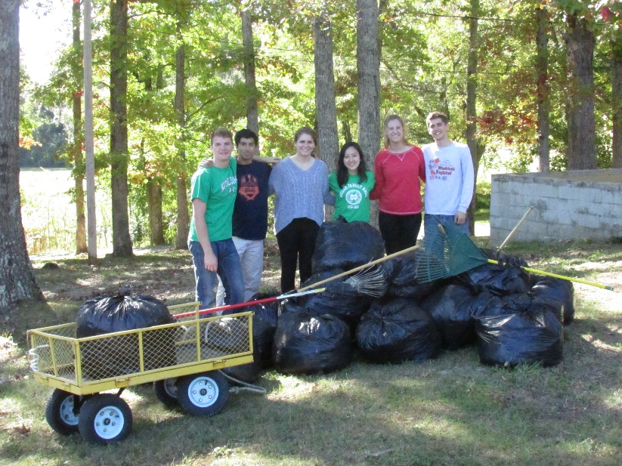
The Option for the Poor and Vulnerable – doing work for those who cannot do it themselves
The week was full of construction for people who cannot afford to fix their dilapidated homes. I did prep work for Tammy’s house on Monday and spent the entirety of Wednesday and Thursday at Barbara’s house, tarring her roof, insulating her pipes, replacing her windows, and more.
On Monday, my group spent a lot of time chopping wood that was delivered to people who do not have the utilities to heat their homes and cannot afford to acquire firewood themselves.
On Tuesday, I went to Kingswood, a home for children and teens who are basically orphan’s – their parent cannot afford to take care of them, or they were legally taken away from their parents. Although we did not interact with the kids, we did maintenance work and raked leaves.

Slide 6
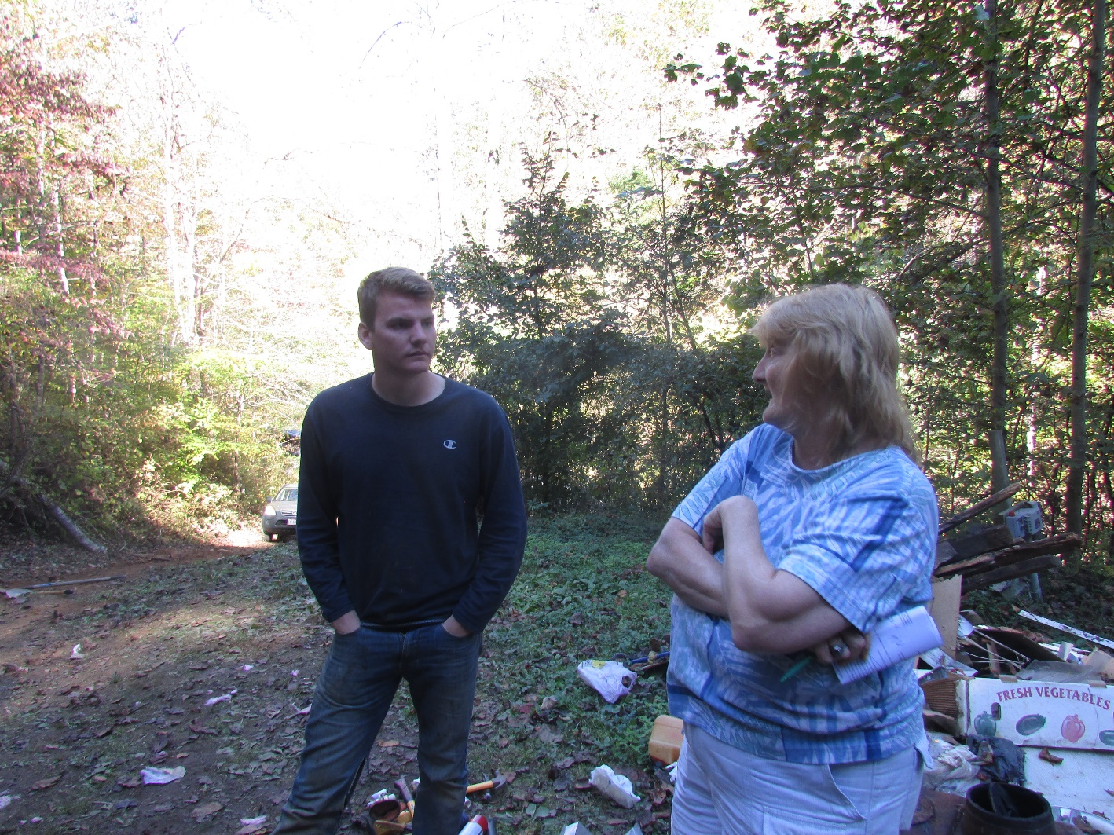
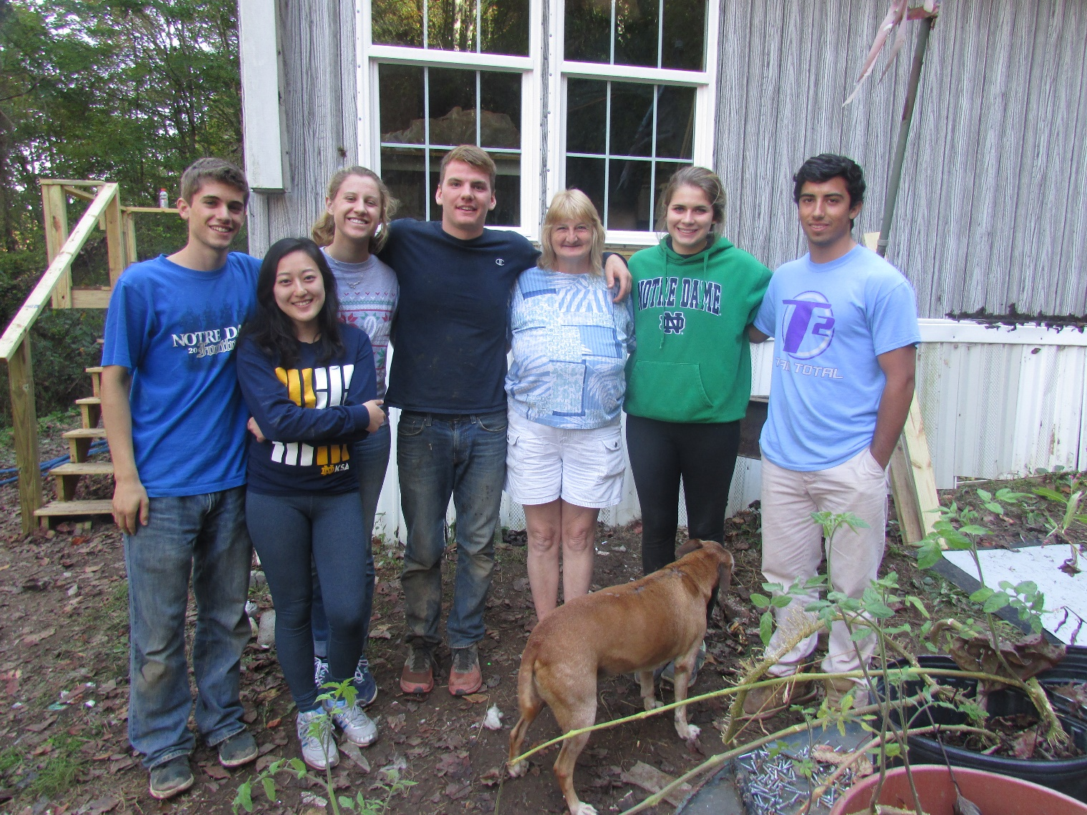
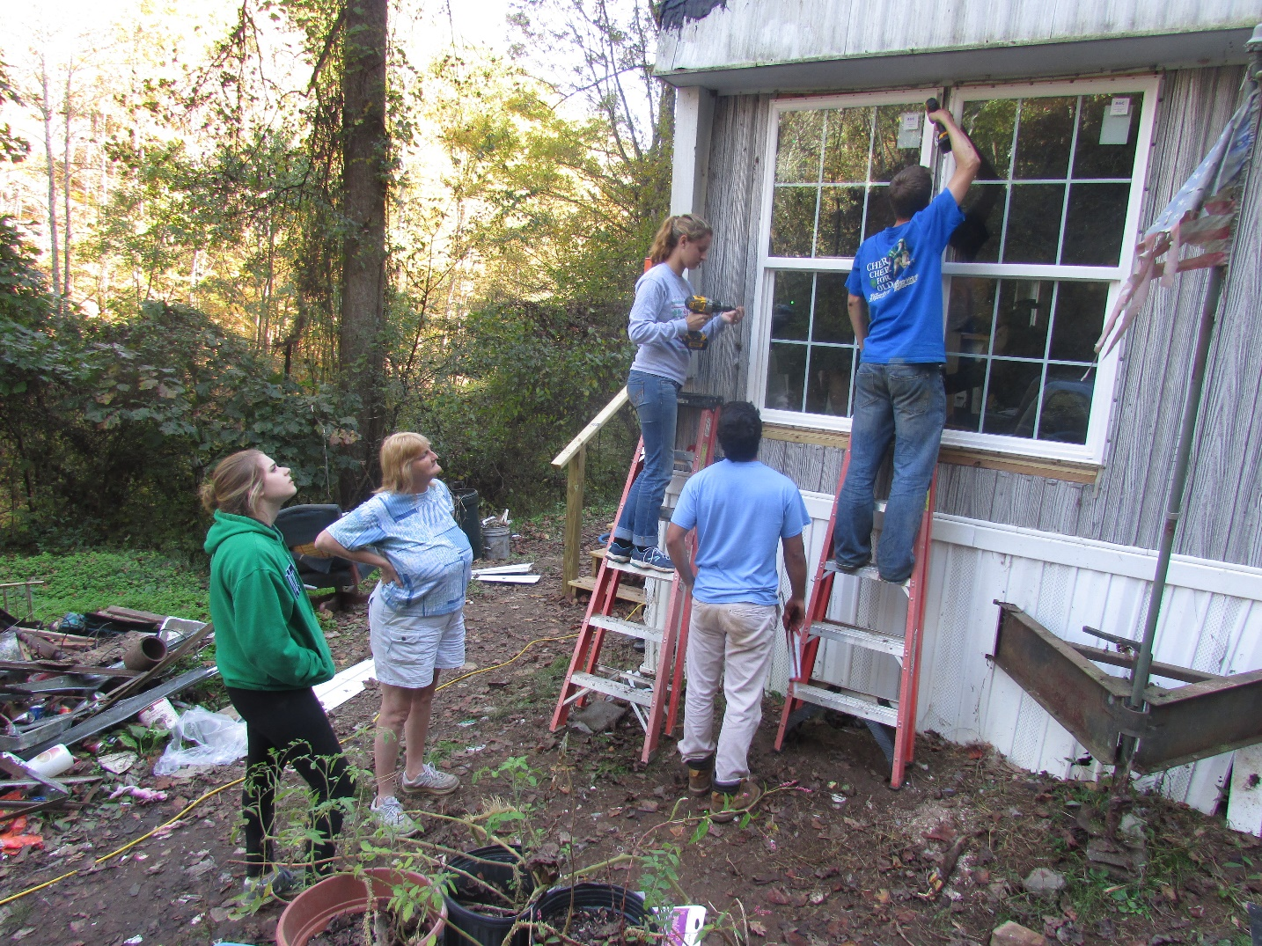
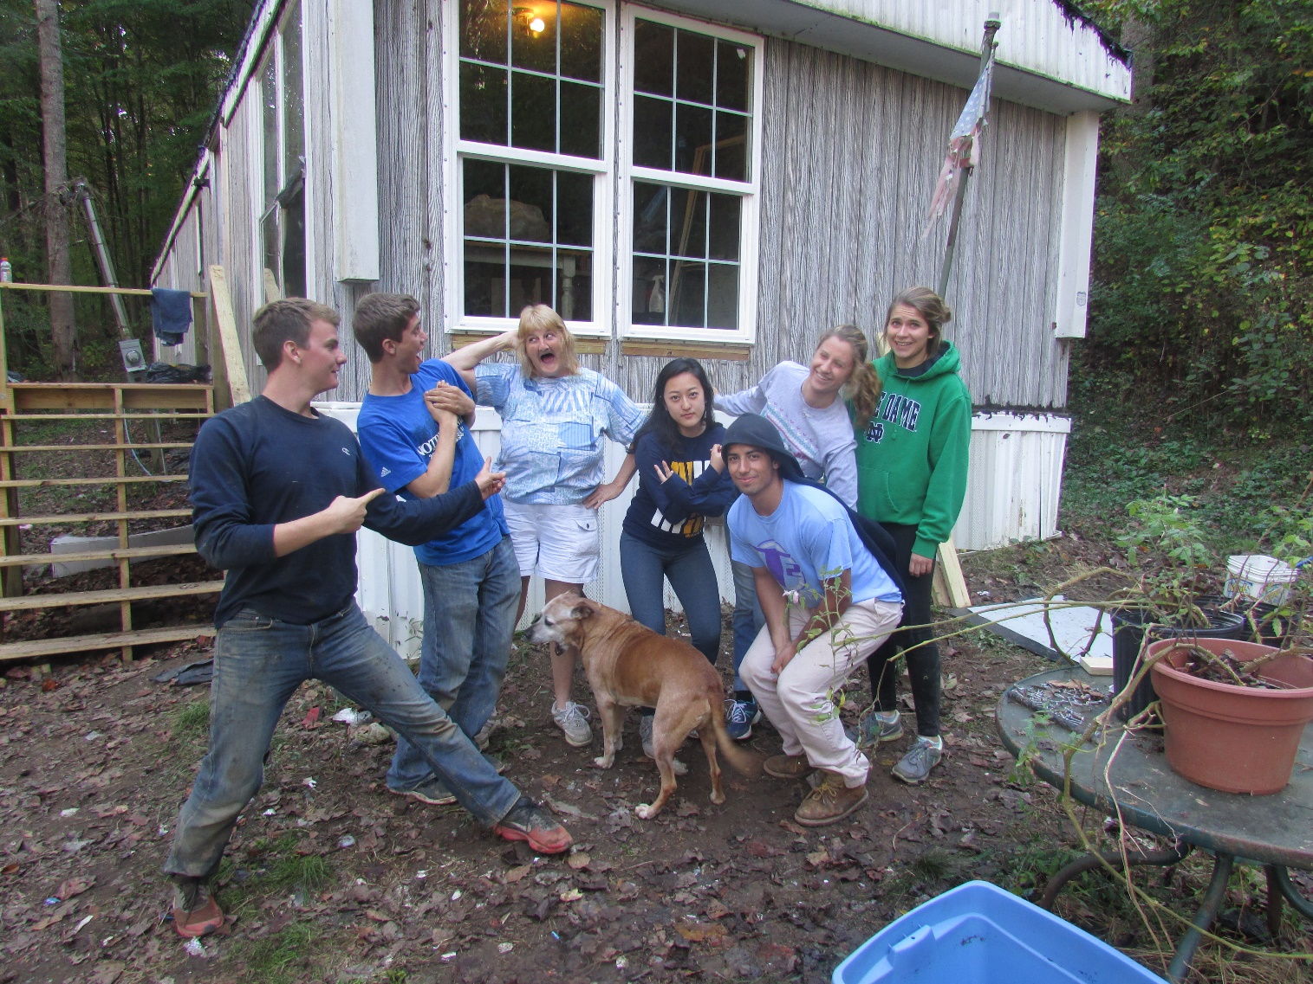
I realized how much The Option for the Poor and Vulnerable goes hand and hand with Respecting the Life and Dignity of the Human Being
The most powerful moment on my immersion was when I was underneath Barbara’s house, insulating the LAST pipe that was to be insulated, and the pipe burst and I was drenched in water. Me being drenched in water was not the problem.
Barbara immediately felt very sad for me, and brought be into her home and turned on her portable heater. As I sat on her floor, she woefully talked to herself – how would she spend ANOTHER night with no water, how she will be unable to afford another fix, and how she just spent all her credit on her grandkids because her daughter cannot support them herself. THAT was when I felt horrible.
I saw the absolutely reality of living in poverty. Barbara lives without the basic need of adequate shelter. She spends some days without water since her pipes burst in the winter (thus they needed insulations) and her house leaks with water and becomes mold infested (the reason we tarred her roof and replaced her windows). My moment of wetness and coldness was NOTHING compared to what Barbara faces every day.
Luckily, Mia knew how to fix the pipe, but she had to run to the store to buy a part. This left me and two of my classmates alone at Barbara’s house for a half hour. I brought the other two inside and we talked to Barbara, and listened to her life story and the hope she has in God’s plan for her.
Barbara became and extremely important part of my trip, and I hope she stays with me throughout my life.

Slide 7
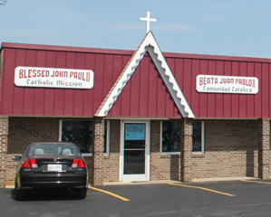
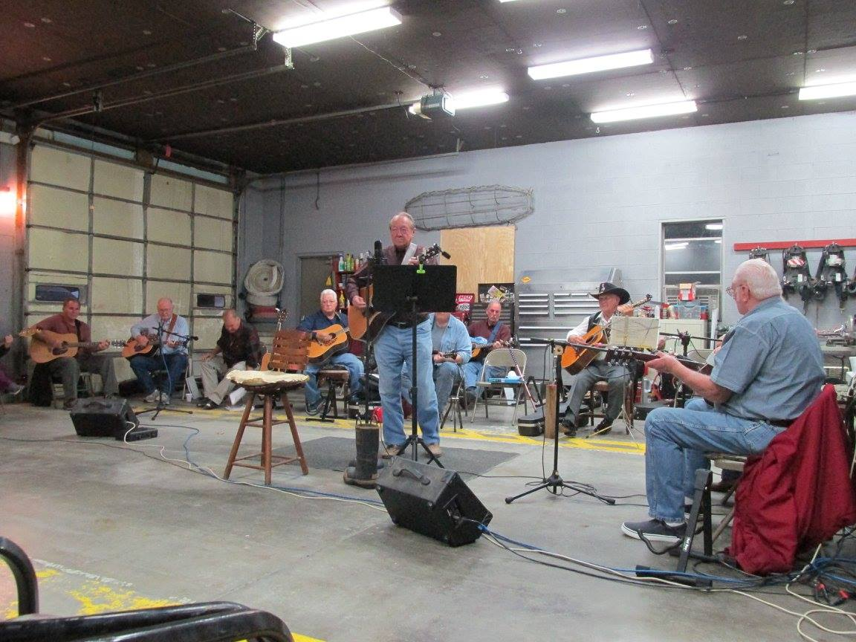
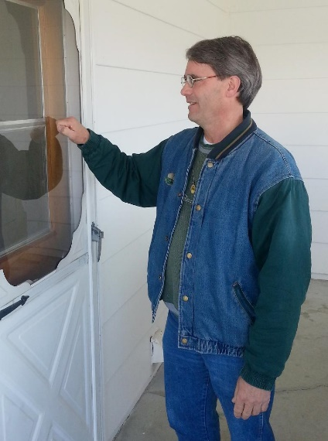
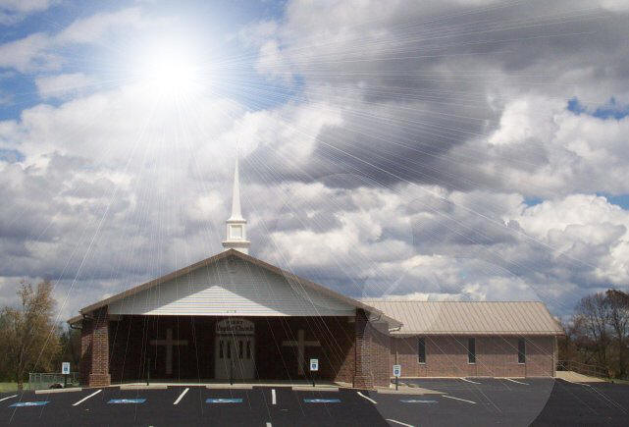
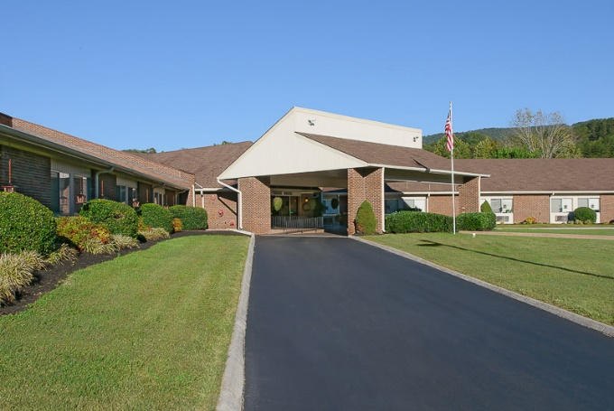
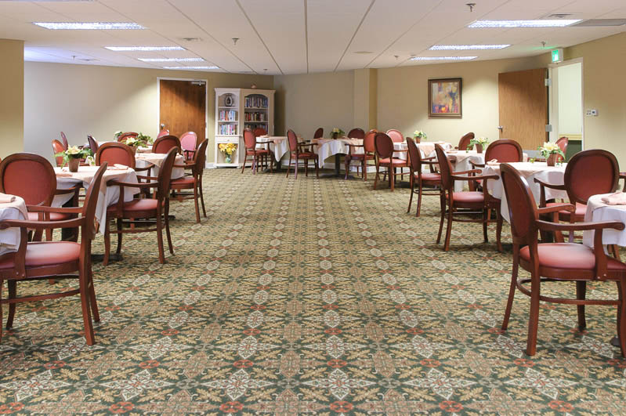
Solidarity – Being With the People
Monday Night, we went to Paulette Firehouse for Appalachian music and dancing. My entire group did a “4-Step” to Wagon Wheel and a nice old woman named Joyce kept taking me up to the dance floor throughout the night.
On Wednesday night, Mark and Mia took our group to Washburn Baptist Church, to learn from our Christian brothers and sisters, experience a Baptist service, and workshop God in a very different way.
We celebrated mass Thursday night at the only Catholic Church in the county, founded by Glenmary, and stayed after for a potluck dinner with the parishioners. Other than my group, 80% or so of the parishioners were Hispanic and came up to Tennessee to work in the fields. Mark and Mia said half were probably here illegally.
We also got to meet Brother Craig, who spoke to us about what the Glenmary order of Priests and Brothers is all about.
During the day on Friday, my group went to a nursing home to talk and play bingo with the elderly and sick people who live there.

Slide 8
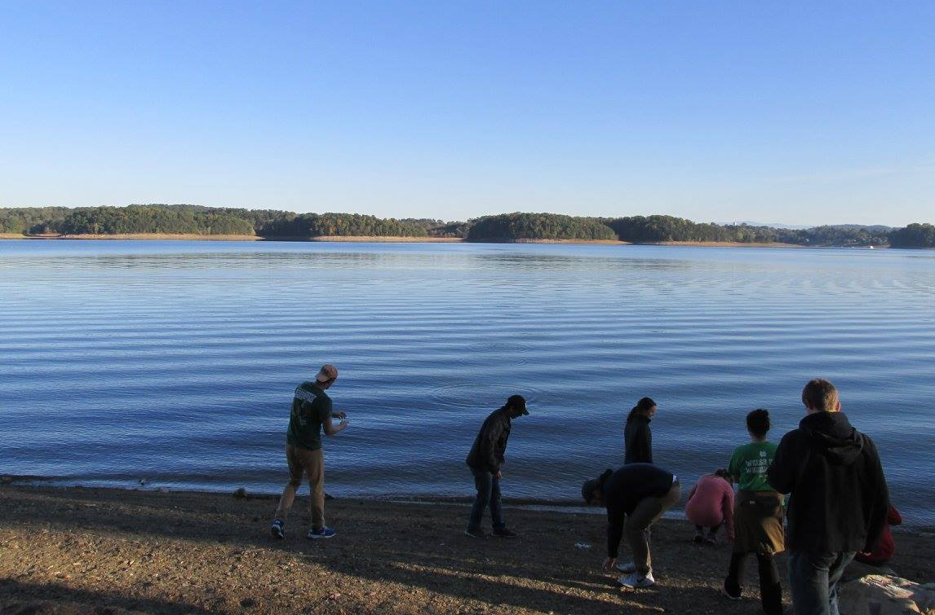
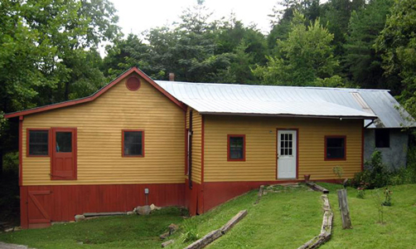
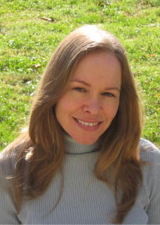
Caring for God’s Creation
On Tuesday, we ate dinner at a park located on Cherokee Lake. The lake was made by a dam. It was great to see the beauty of the area and also nice to see the production of energy naturally (as opposed to coal mining).
On Friday, we took a very unexpected visit to Narrow Ridge Eco Literacy Center. The Center is an off-the-grid living area where everything is environmentally friendly and powered naturally. There was a great meeting of people: my whole Appalachia group along with Mark and Mia, a different Notre Dame CSC seminar group who spent the earlier half of the week in Washington talking to politicians about energy conservation, the managers and residents of Narrow Ridge, Brother Craig, and Mitzi (who sang with the Emancipators at Notre Dame). We ate dinner together and then all shared the experiences we had in the past week.

Slide 9
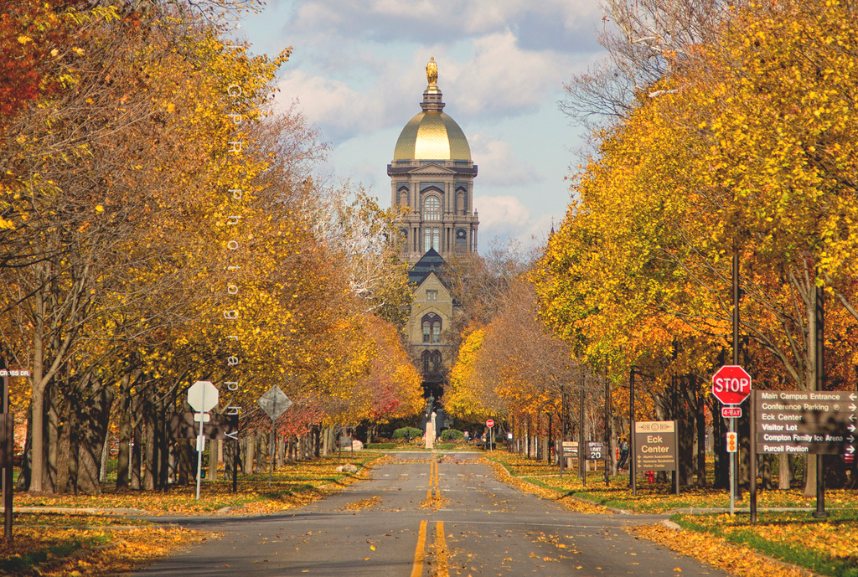
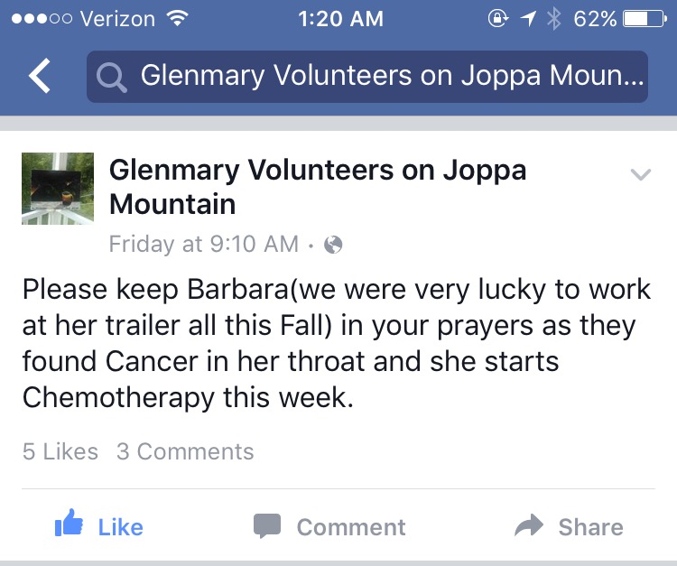
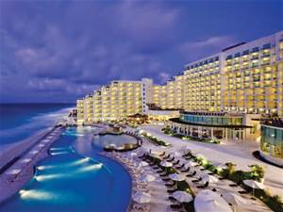

Post Immersion - Now what?
My fears that this fall’s Appalachia immersion would not live up to last spring’s did not come true.
If anything, this immersion surpassed my previous one.
I had a very deep cultural experience, and I have been sharing it with others.
I recently saw on Glenmary’s facebook page that cancer was found in Barbara’s throat. She will be in my thoughts and prayers and I plan to write to her soon.
Living simply for a week was great, I feel as if I am less addicted to my phone and value living in the moment on God’s time more than I did before.
Punta Cana next Spring Break? Nahhh
I plan to return to Appalachia next spring, and hopefully as a group leader!

